Slide 1
MPU3272-WPCS Writing Job Application Letter / Cover Letter

Slide 2
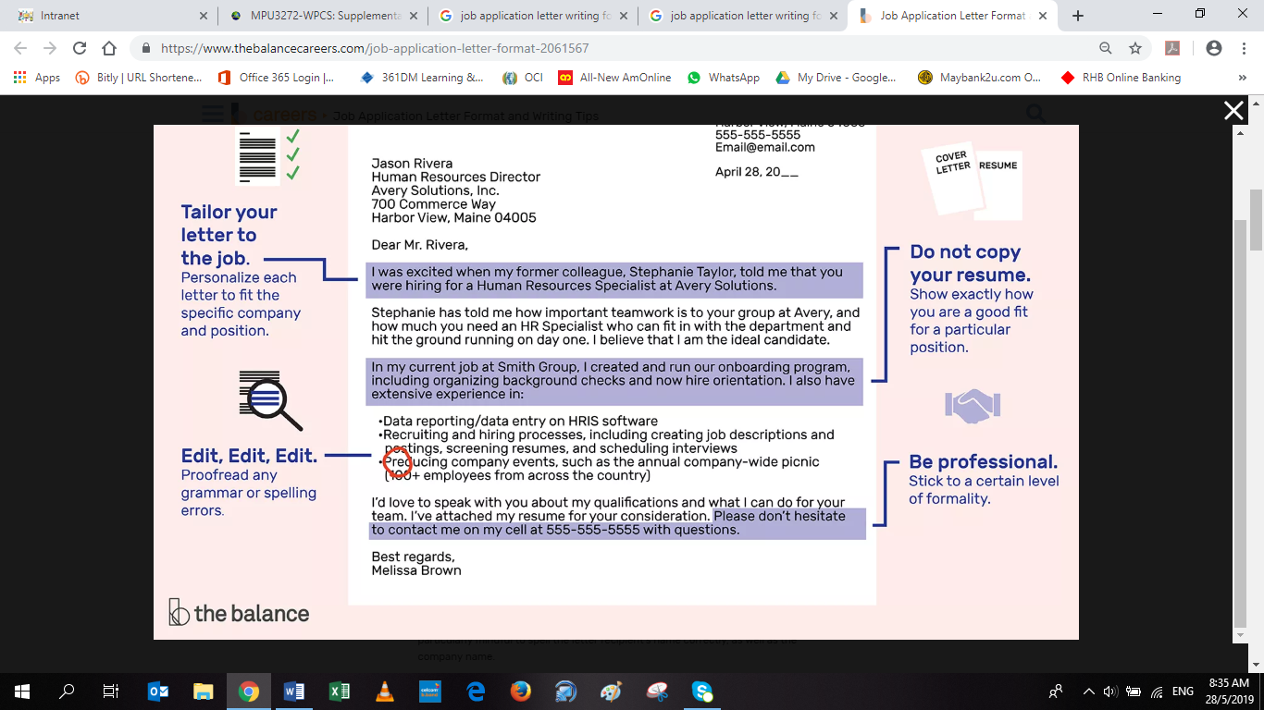
Writing Job Application Letter

Slide 3
Do not copy your resume. The purpose of this letter is to show that you are a strong candidate and to highlight your relevant experience and abilities. Your resume is a general record of your experience, education, and accomplishments. In contrast, your application letter should show how exactly your background makes you a good fit for a particular position.
Important: Since your application letter will be accompanied by your resume, make sure the letter does not duplicate your resume exactly.
Tailor each application letter to the job. As mentioned above, emphasize in your letter why you are an ideal candidate for the specific job. This requires that you personalize each letter to fit the specific company and position. Here's information on how you can closely match your qualifications to the job posting.
Be professional. Application letters have a fairly rigid format — as hiring managers read your letter, they will expect to see certain information included in set areas. You have freedom within the structure to be personable, but it is important to stick to a certain level of formality. Pay particular attention to the professionalism of your salutation and what you call the employer. You wouldn't, for instance, want to refer to the letter's recipient by the first name unless specifically requested.
Edit, edit, edit. Employers are likely to overlook an application with a lot of errors. Therefore, read through your cover letter, and even consider asking a friend or career counselor to read the letter. Proofread any grammar or spelling errors. Be particularly mindful to spell the letter recipient's name correctly, as well as the company name.

Slide 4
Job Application Letter / Cover Letter
Also called as cover letter
Written to sell one’s services
Drafted carefully as it is related with one’s career
Carries sequence of information regarding the qualification & experience

Slide 5
Guidelines for Writing Job Application Letter
1st paragraph:
Why you are writing?
to express your interest in …
name of the position
how you heard the opening in this company i.e: friend, senior, university, website…
2nd paragraph:
Current studies…major?
background of studies…
your company prominence in similar areas
3rd paragraph:
Your interest after graduation…
4th paragraph:
Your past experience …
project at University &
what you learned .. Emphasize skills or abilities related to job you applying
why are you the best candidate…
5th paragraph:
Opportunity to meet:
indicate your desire for a personal interview…
my contact number / email address
Thank you for your consideration

Slide 6
Structure of an Application Letter
Date of Letter
Applicant’s complete address
Employer’s complete name, Title & Address
Salutation: Mr./Ms. Last Name
Letter Content/Body
Closing (Sincerely … / Respectfully…)
Enclosure (resume or other enclosure used, note in your letter)

Slide 7
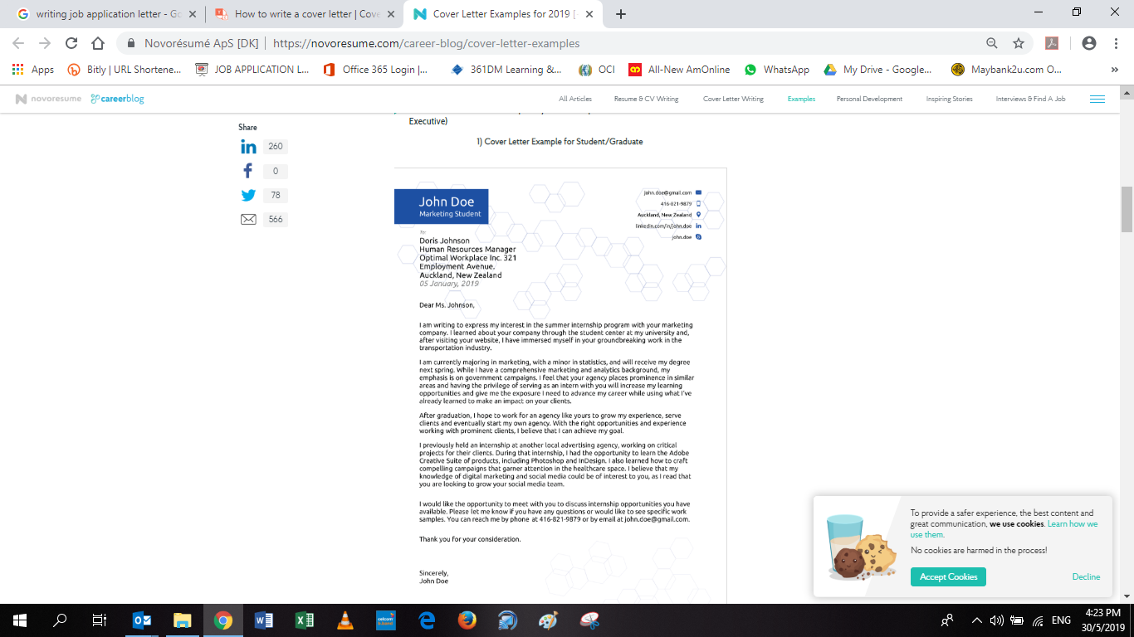

Slide 8
Thank you & All the Best

